Slide 1


DAV INSTITUTE OF ENGINEERING & TECHNOLOGY,JALANDHAR DEPARTMENT OF ELECTRONICS AND COMMUNICATION
Industrial Training
Submitted By :-
Kritika
University Roll No. :1803775

Slide 2
CONTENTS
About company
List of technologies taught to .NET interns
About .NET
Introduction to C#
Project
About the problem
Objectives
Development Environment
Implementation
Conclusion

Slide 3

ABOUT COMPANY
Wipro Limited (formerly, Western India Palm Refined Oils Limited) is an Indian multinational corporation that provides information technology, consulting and business process services.
Delaporte has served as CEO and managing director of Wipro from July 2020. It is headquartered in Bangalore, Karnataka, India.
It harnesses the power of cognitive computing, hyper-automation, robotics, cloud, analytics, and emerging technologies to help clients adapt to the digital world.

Slide 4
Wipro Limited is a leading global information technology, consulting, and business process services company.
Company's IT Services business provides a range of IT and IT-enabled services. IT Products segment provides a range of third-party IT products, which allows it to offer IT system integration services.
The Company offers integrated business solutions that span across enterprise applications and digital transformation to security and testing.
Vision: The vision of Wipro includes being a leader in areas of business, customer, and people. • The company aims to be among the best IT company in India and the world. • Its goals also include being the first choice among customers and employees. Mission: To be RF system solution provider, through its innovative Research & Design works for a new world of Broadband Wireless Communications.

Slide 5

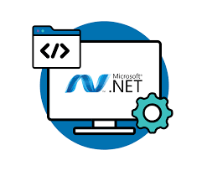
LIST OF TECHNOLOGIES TAUGHT TO .NET INTERNS
.NET and C#(Basic technologies)
C# fundamentals
Object Oriented Programming
Inheritance , Polymorphism , Exception and File handling
Collections in C#
Overview of unit testing NUNIT Framework
Overview of Advanced C#

Slide 6
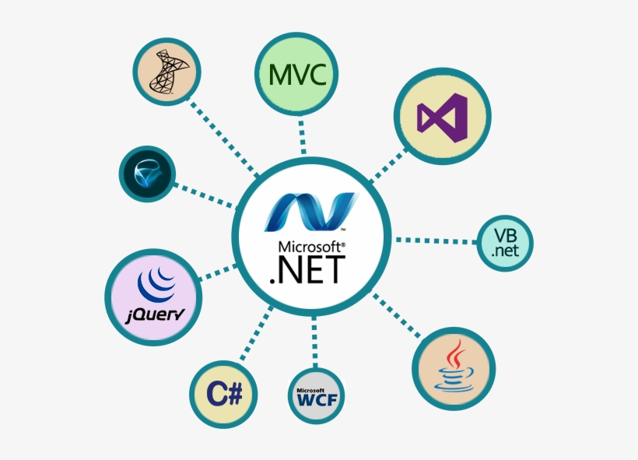
Introduction to SQL and RDBMS
ASP.NET
Overview to web API Core
ADO.NET and EF Core
Overview of microservices

Slide 7

About DOTNET
.NET is a free and open-source, managed computer software framework for Windows, Linux and macOS .
The project is primarily developed by Microsoft employees by way of the .NET Foundation and released under the MIT License .
It supports three languages ;C#,F# and visual basic.
.NET supports the Common Language Infrastructure(CLI), so your source code is compiled into a Common Intermediate Language(CIL).

Slide 8
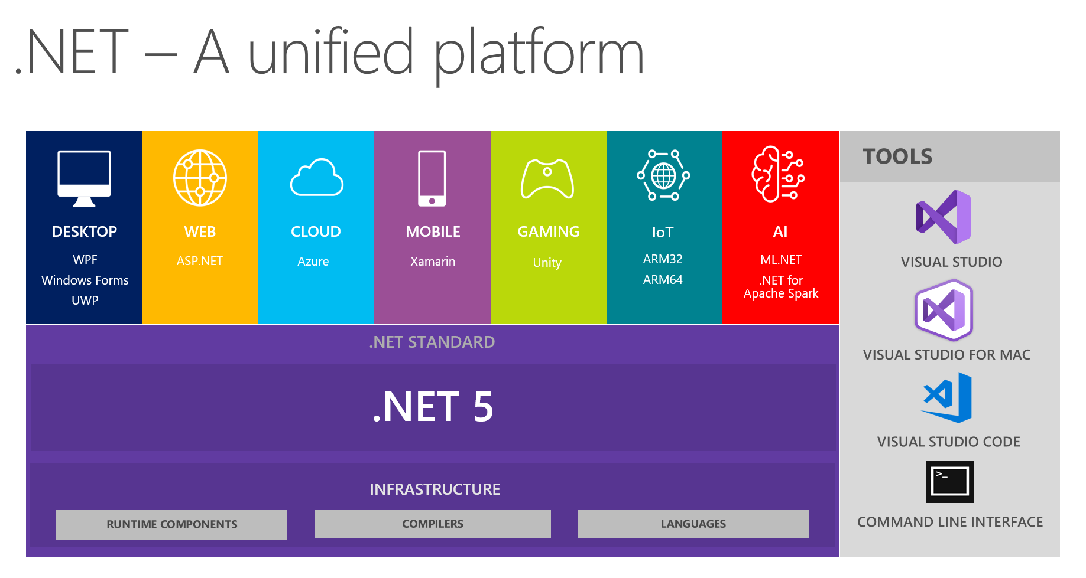

Slide 9
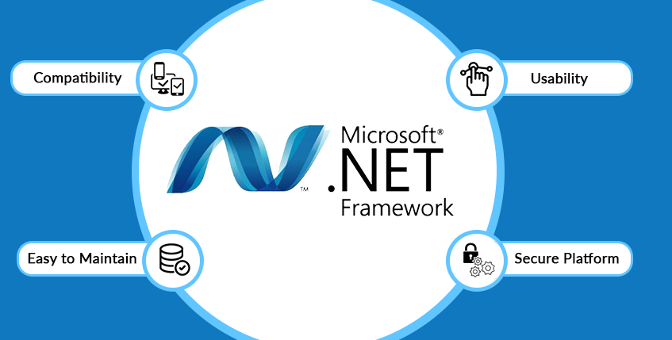
About dotnet framework:-
.NET framework is developed by Microsoft, and it is a software framework. It runs mainly on Microsoft Windows.
The .NET framework provides an environment that removes the various problems that arise due to interpreted or scripted environments.
An object-oriented programming environment is provided by the .NET framework
The .NET framework also provides an environment that leads to a consistent developer experience .
There are minimal software deployment as well as versioning conflicts due to .NET framework.

Slide 10
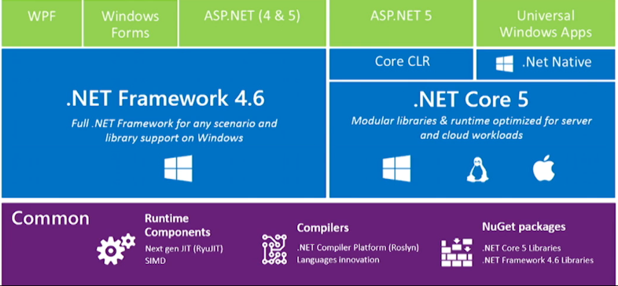

Slide 11

INTRODUCTION TO C#
C# is a general-purpose object-oriented programming language with multiple paradigms. It was designed for Common Language Infrastructure (CLI) in 2000 by Microsoft for its .NET framework.
C# has multiple points that make web development solutions faster as well as easier. Some of these are garbage collection, scalability support, type safety, easier type declarations etc.

Slide 12
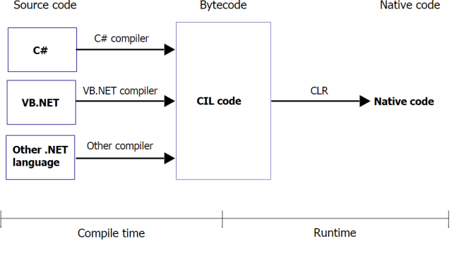

Slide 13
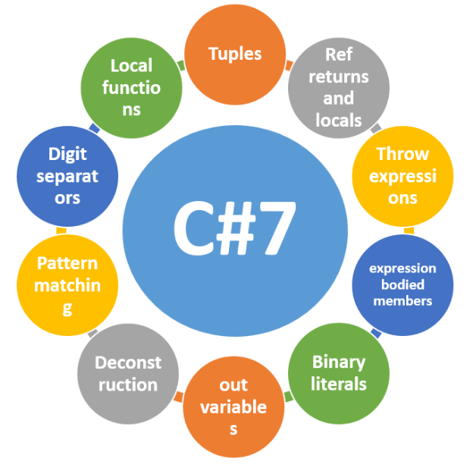
Features of C# -
Object Oriented Language-C# is an object-oriented language. This means that development is easier if there are long codes in large projects as compared to procedure-oriented programming languages.
Structured programming language-The programs in C# can be structured by breaking them into smaller parts using functions.
Simple to use-It is quite simple to use C# as it has various features and functionalities.
Scalable language-C# is an automatically scalable as well as updatable language.

Slide 14

PROJECT- ONLINE ADZ

Slide 15

ABOUT THE PROBLEM
This problem is assigned to me during my internship at WIPRO Limited. To design an “Online advertising platform” using Visual Studio, ASP.NET MVC, Microsoft SQL Server Management Studio, with the necessary functionalities as given.
Create an online advertising platform. A user can post his ads on this platform. The system will be on windows platform using C#, ASP.NET, SQL, Entity Framework Core. We can also deploy the Application on cloud.
There are two types of users for the web application, Admin, and a User. Both are having different functionalities. Data organization is done using SQL Server by creating the necessary normalized tables.

Slide 16
OBJECTIVES
There are two types of users. Admin administrates the website. User can view or update his ad and can ask Admin to post his ad.
Admin and user both are having different functionalities and their pages are having different layouts. Also , one can edit ,delete , create and view respective details.
Login and registration functionalities help having smooth experience for the user.
Data is stored in the required normalized tables with the help of SQL Server.
The overall method is very easy and based on few steps. No huge amount of knowledge is needed to complete the task.

Slide 17

DEVELOPMENT ENVIRONMENT
Apart from basics i.e., .NET and C# we have-
1.Visual Studio
Visual Studio is an Integrated Development Environment(IDE) developed by Microsoft to develop GUI(Graphical User Interface), console, Web applications, web apps, mobile apps, cloud, and web services, etc.
It uses the various platforms of Microsoft software development software like Windows store, Microsoft Silverlight, and Windows API, etc.

Slide 18
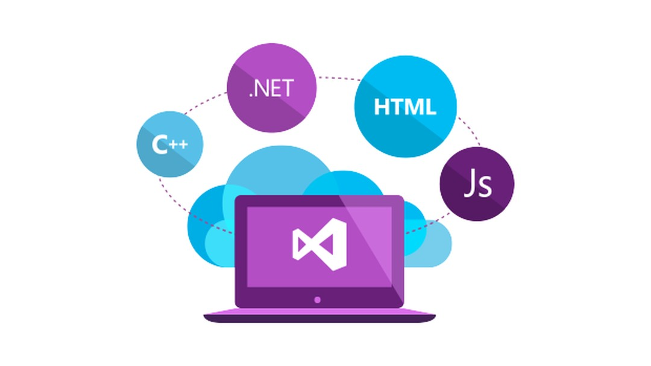
It provides support for 36 different programming languages and is available for Windows as well as for macOS.
There are 3 editions of Microsoft Visual Studio -Community, professional and enterprise.
IntelliCode in VS is a powerful set of automatic code completion tools that understand your code context.
CodeLens in VS helps you easily find important insights, like what changes have been made, what those changes did, and whether you’ve run unit testing on your method.
It also provides great tool support for Web Technologies like; HTML, CSS, JSON.

Slide 19

2. SQL
A database is an organized collection of data so that it can be easily accessed. To manage these databases, Database Management Systems (DBMS) are used.
In Non-RDBMS, data is stored in key-value pairs. In RDBMS, data is stored in tabular format. The first row is the attributes of the table. Each row after that contains the data of a customer.
Structured Query Language (SQL) is a standard query language that is used to work with relational databases.

Slide 20
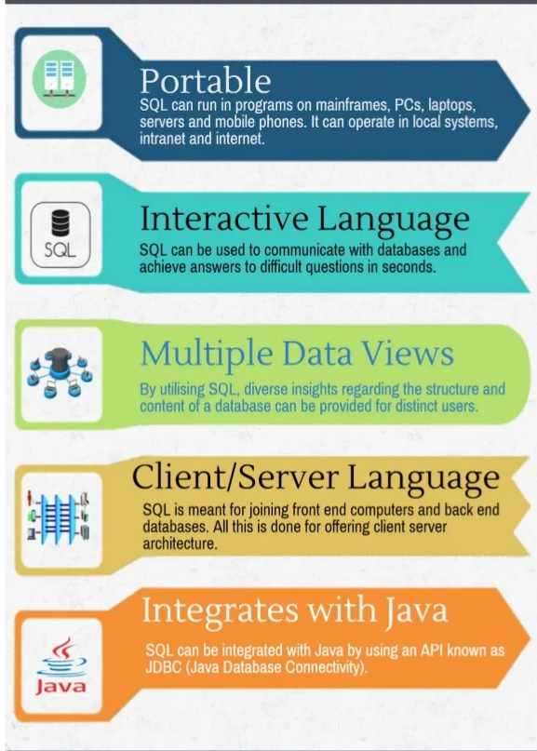
Features of SQL:
SQL is used to access data from relational database management systems.
SQL can execute queries against the database.
SQL is used to define the data in the database and manipulate it when needed.
SQL is used to create and drop the database and table.
SQL is used to create a view, stored procedure, function in a database.
SQL allows users to set permissions on tables, procedures, and views.

Slide 21

3.Microsoft SQL Server Management Studio:
SQL Server Management Studio is a free multipurpose integrated tool to access, develop, administer, and manage SQL Server databases, Azure SQL Databases, and Azure Synapse Analytics.
SSMS can also be used to access, configure, manage & administer Analysis services, Reporting services, & Integration services.
SSMS runs only on Windows. Use Azure data studio to run on your macOS or Linux.

Slide 22
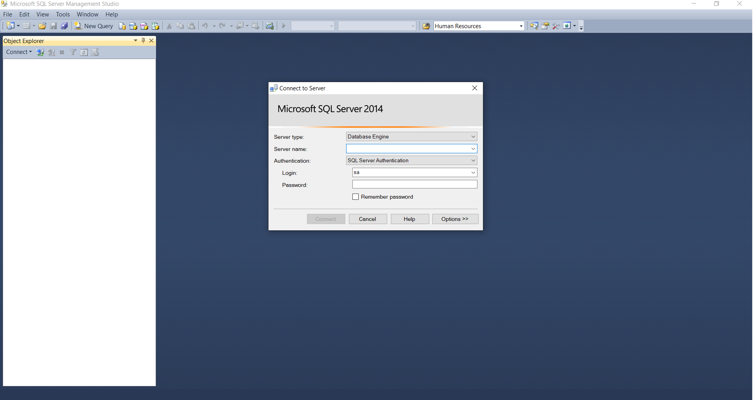

Slide 23

Components:
Some features in SSMS that makes it popular-
Object Explorer
Query Editor
Template Explorer
Query Execution Plan
Table Designer
Database Designer
Query and View Designer
Generate and Publish Scripts Wizard
Backup and Restore
SQL Server Security Management
Activity Monitor
XEvent Profiler

Slide 24
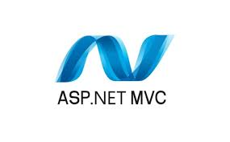
4. ASP.NET MVC and Entity framework:
ASP.NET Core is a free, open-source, and cross-platform framework for building cloud-based applications, such as web apps, IoT apps, and mobile backends.
ASP.NET MVC 5 is a web framework based on Model-View-Controller (MVC) architecture.
ASP.NET MVC framework is the most customizable and extensible platform shipped by Microsoft.

Slide 25
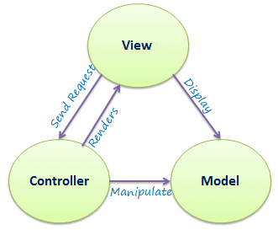
MVC:
Model: Model is a part of the application which implements the logic for the data domain of the application. It is used to retrieve and store model state in a database such as SQL Server database.
View: View is a component that forms the application's user interface. It is uses to create web pages for the application.
Controller: Controller is the component which handles user interaction. It works with the model and selects the view to render the web page. The view only displays information whereas the controller handles and responds to the user input and requests.

Slide 26

Entity Framework:
Entity framework is an Object Relational Mapping (ORM) framework that offers an automated mechanism to developers for storing and accessing the data in the database.
Entity Framework can generate the necessary database commands for reading or writing data in the database and execute them for you.
Entity Framework will execute the relevant query in the database and then materialize results into instances of your domain objects for you to work within your app.

Slide 27
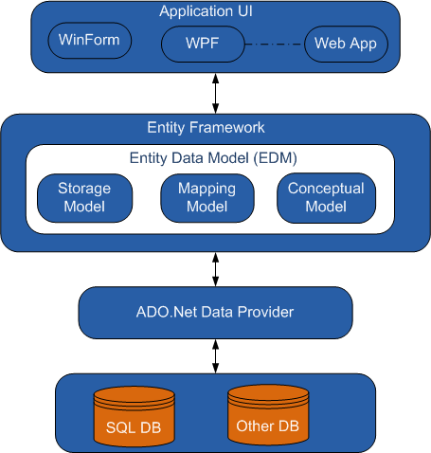
Features of EF Core:
It is a cross-platform framework that can run on Windows, Linux, and Mac.
Entity Framework allows us to use the LINQ Queries to retrieve the data from the database.
Entity Framework allows us to use the LINQ Queries to retrieve the data from the database.
Entity Framework executes the INSERT, UPDATE, and DELETE commands to the database based on the changes that occurred to the entities when we call the "SaveChanges()" method.
Entity Framework automates the management of the transaction while querying or saving the data.
Entity Framework provides a set of the migration commands

Slide 28
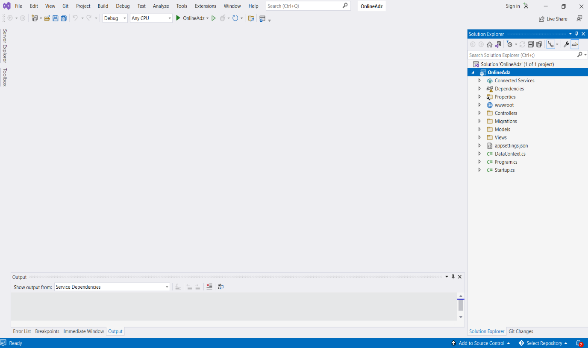
IMPLEMENTATION
As it is an ASP.NET MVC application the basic structure of the project-

Slide 29
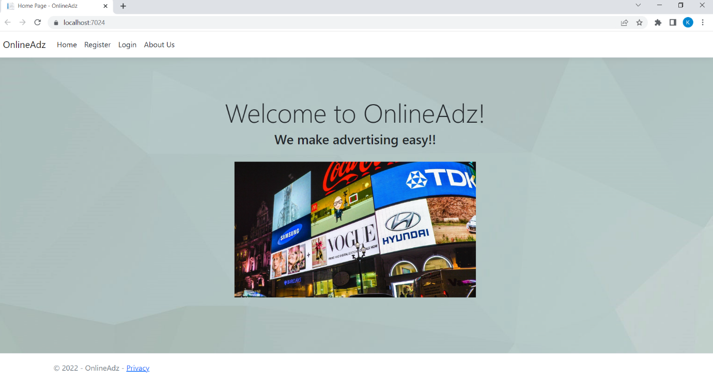
Home Page-

Slide 30
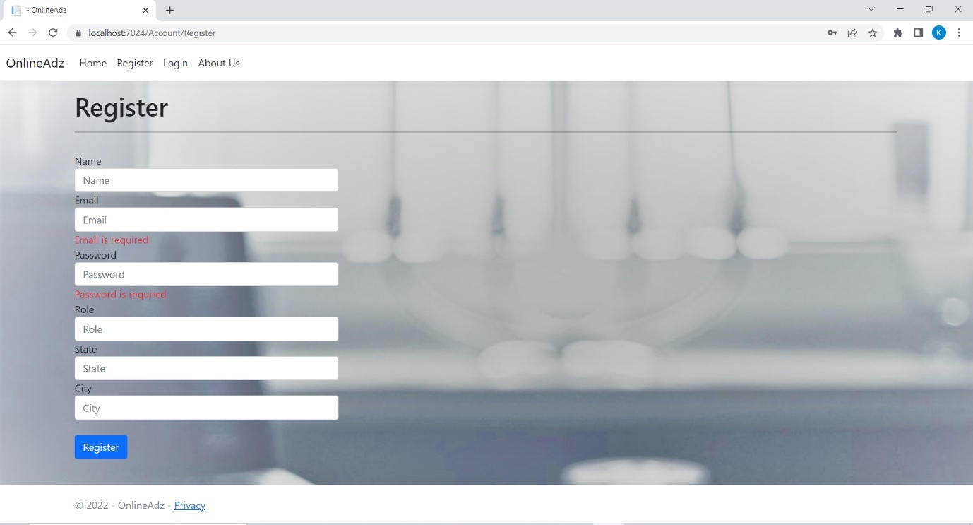
Registration page-

Slide 31
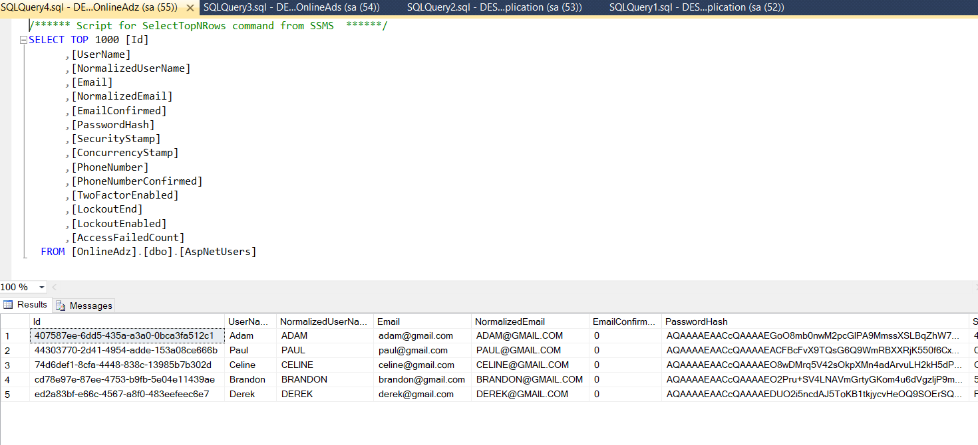
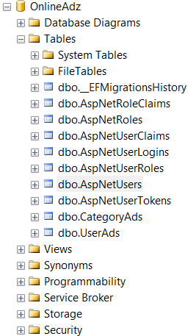
SQL Tables related to registration functionality-

Slide 32
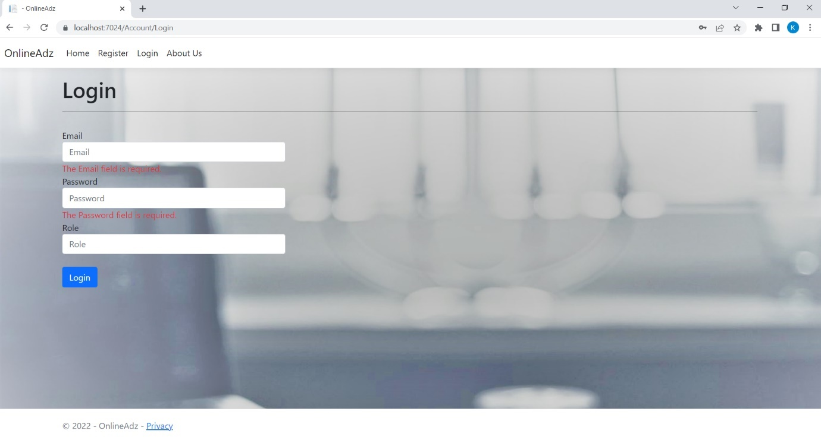
Login page-

Slide 33
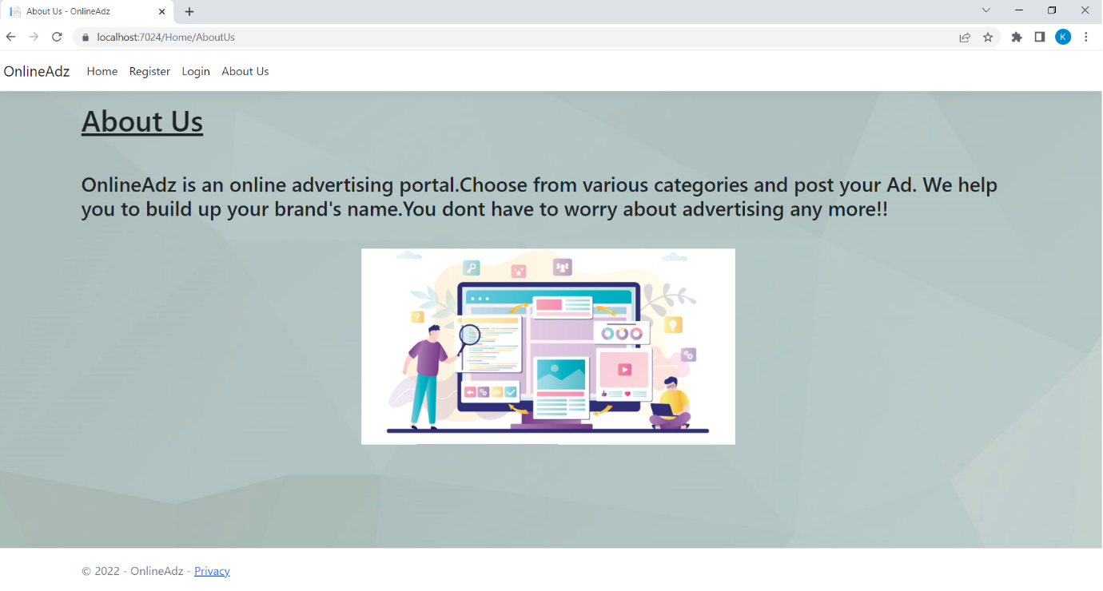
About us page-

Slide 34
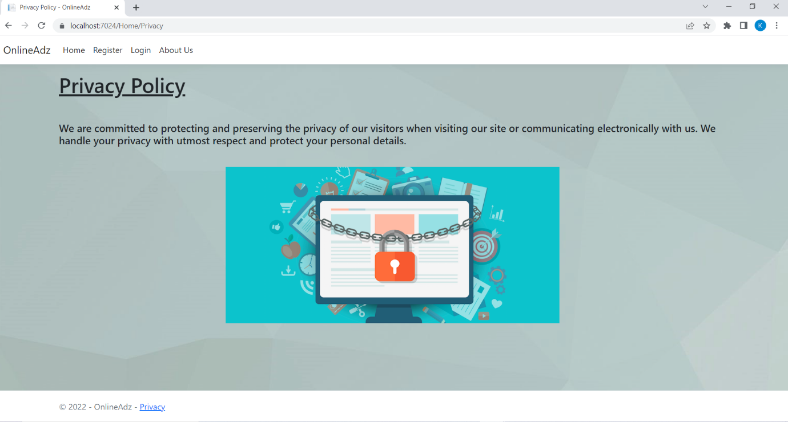
Privacy policy page-

Slide 35
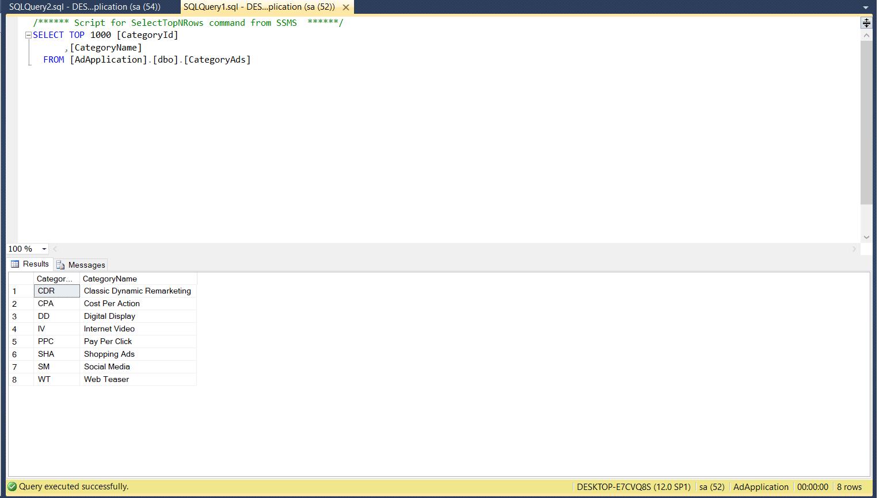
Category of Ads SQL Table-

Slide 36
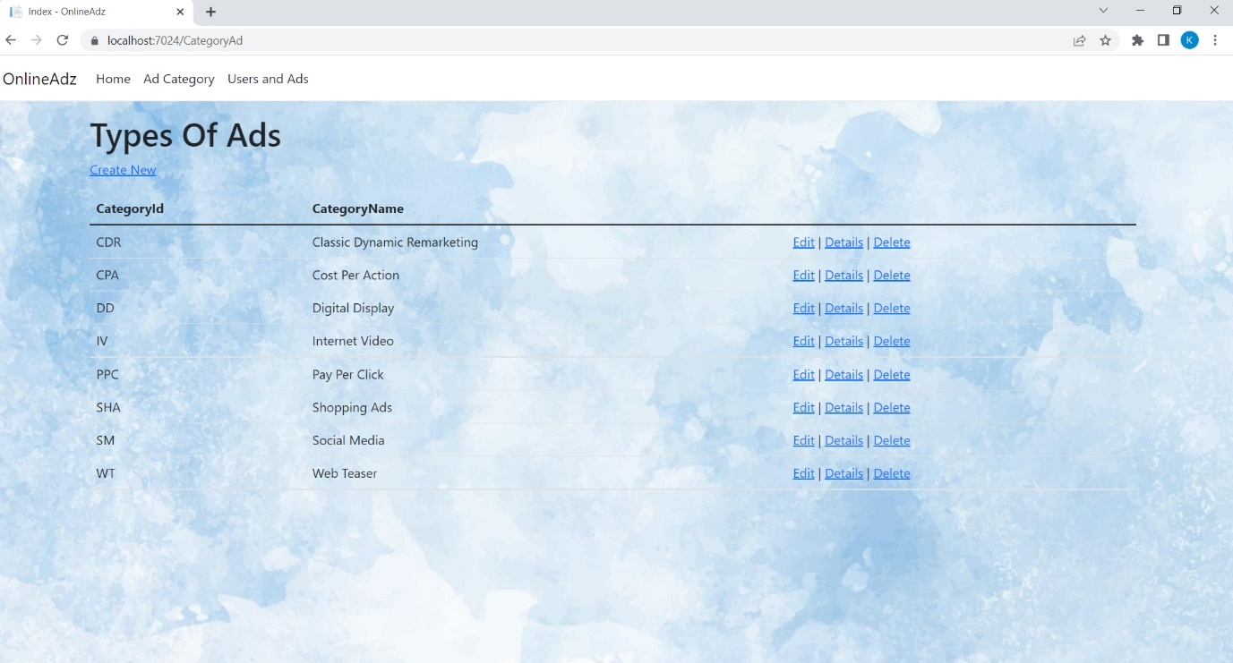
Category of Ads-

Slide 37
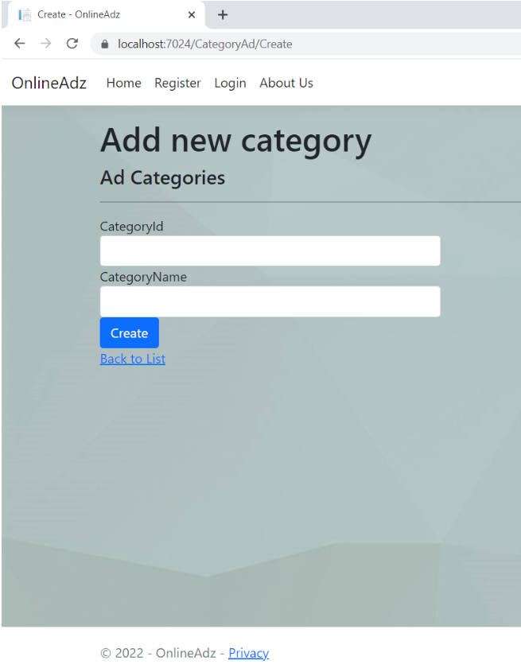
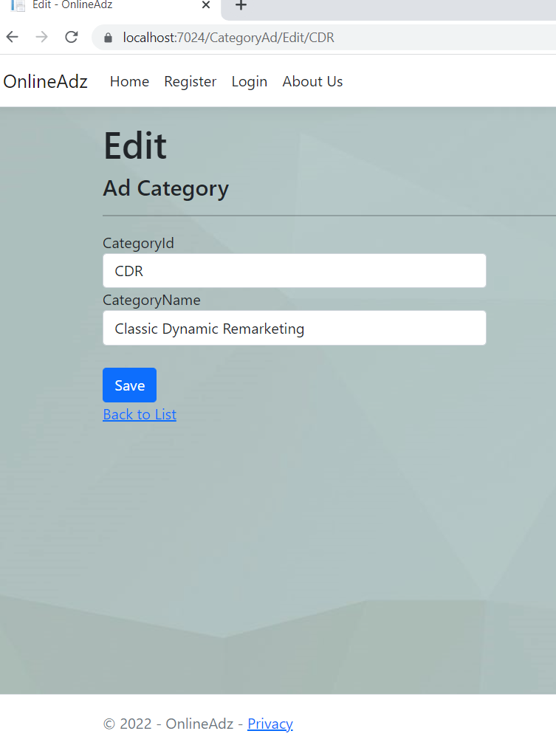
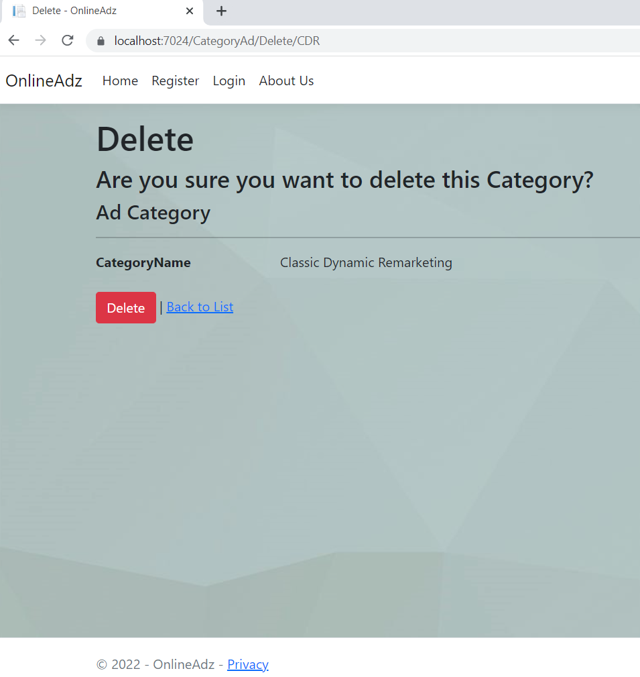
Also, one can edit, delete, create or view details-

Slide 38
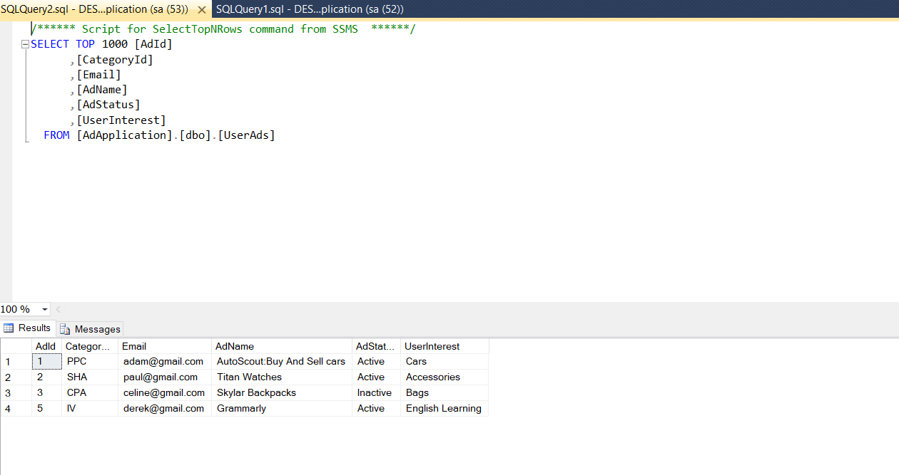
SQL Table for Users-

Slide 39
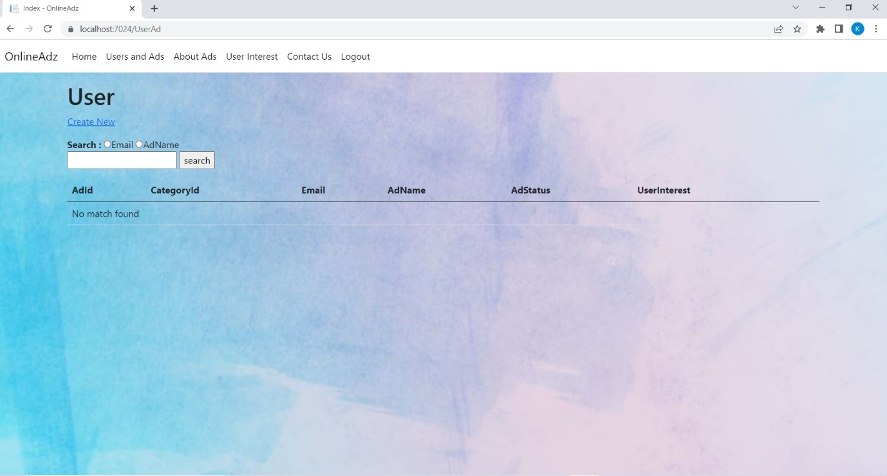
User Page-one have to search for email or ad name for his/her ad details-

Slide 40
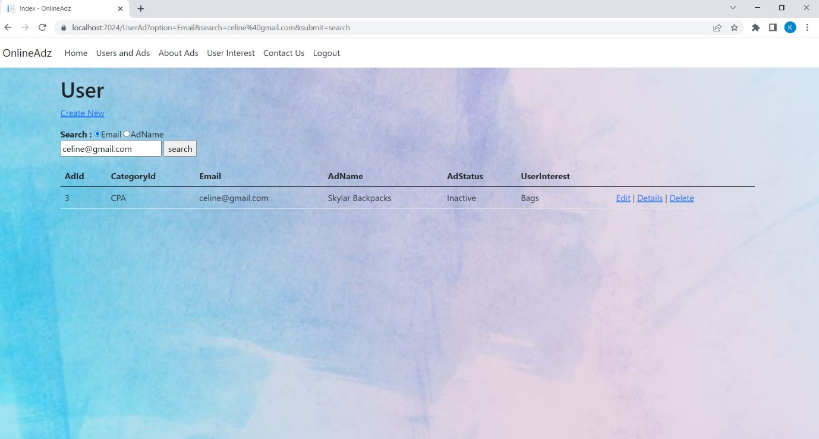

Slide 41
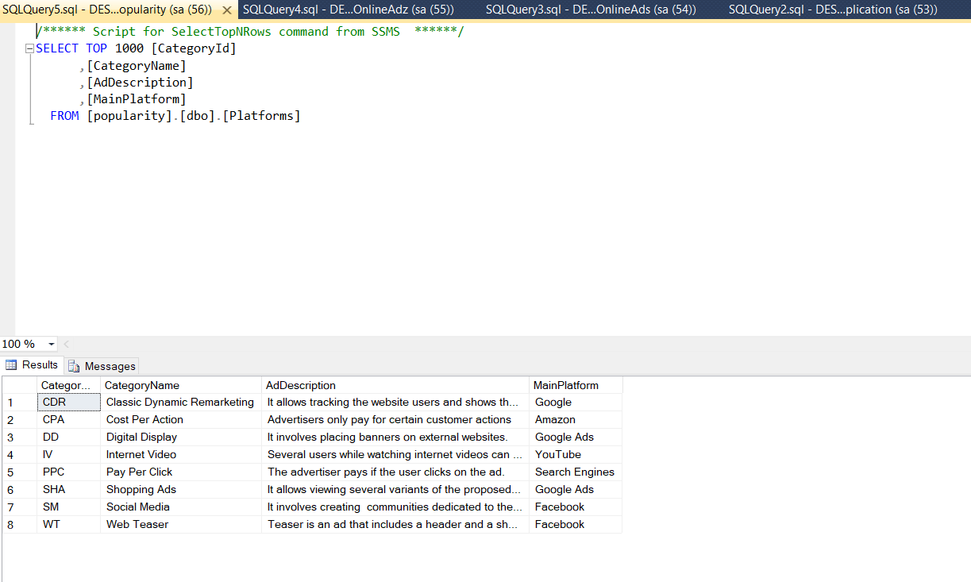
Table for users to chose ad type-

Slide 42
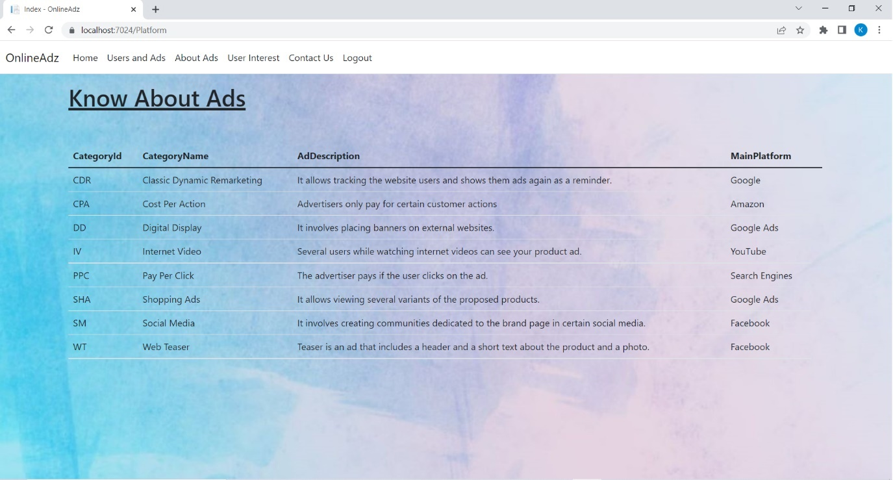
About Ads-

Slide 43
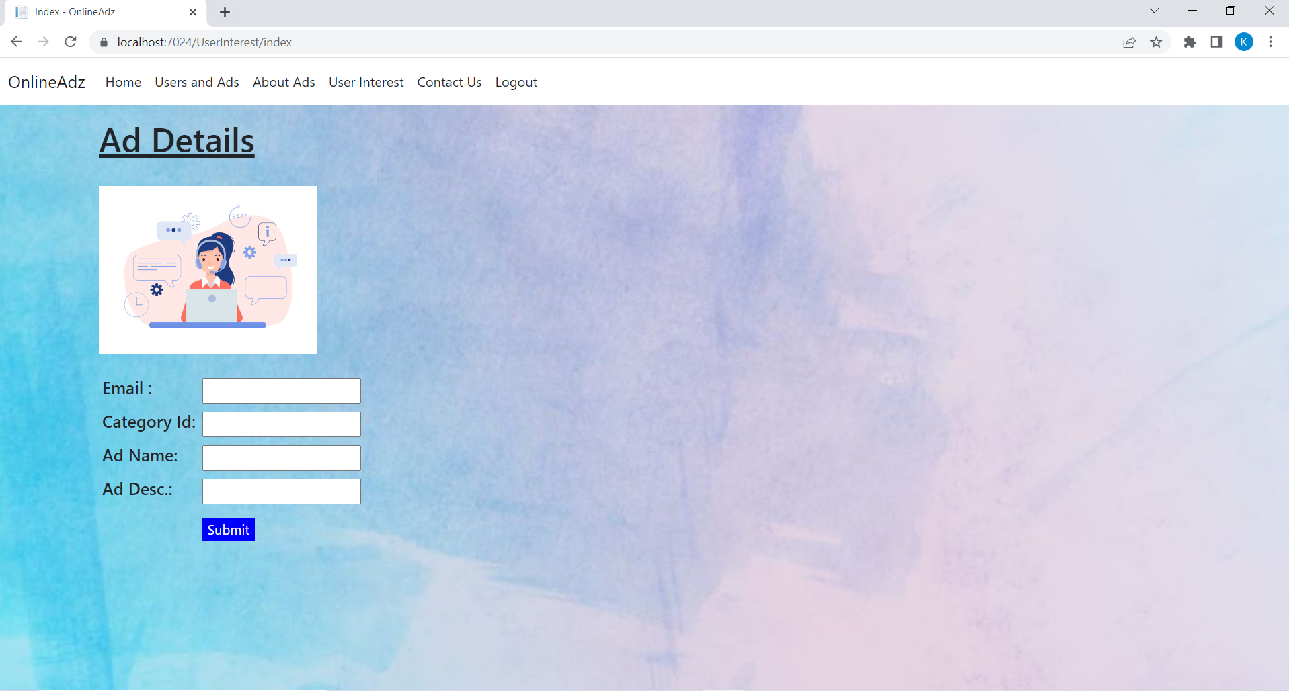
Ad details form-User can give his ad details to Admin -

Slide 44
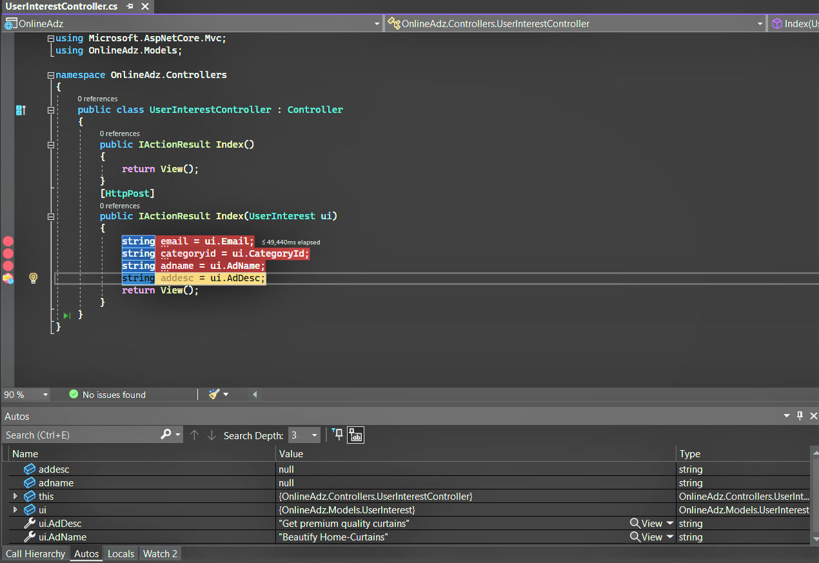

Slide 45
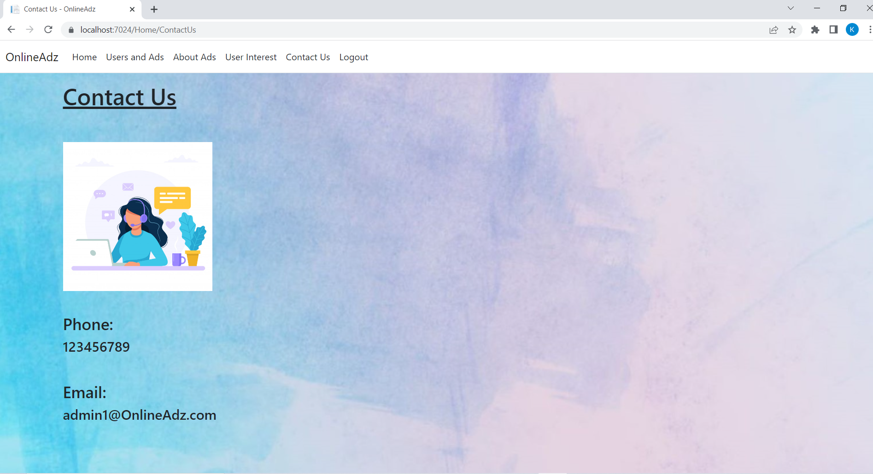
Contact Us page-

Slide 46
CONCLUSION
Working as an intern at Wipro limited was a great experience. The IT industry is one of the leading industries these days. The internship program helped me learn about the growth of this industry and gain further knowledge about it. Working here also helped broaden my technical knowledge in the programming field as before the internship I had little knowledge about Dotnet.
I learned various aspects of Dotnet, C# and SQL and gained some practical knowledge about these technologies as various assignments and mini projects were given on daily basis. The project “Online Adz” will help the users to market their product online. The aim is to post ads and make advertising easy. As social media platforms are very popular these days so advertising online and, on this platform, will be very convenient.
Overall, the internship program helped me develop skills such as handling real-world programs, working under the rules and regulations of an organization, working under a deadline, and working under pressure. It helped me gain technical knowledge as well as professional experience which will be very helpful through my professional career.

Slide 47


